Slide 1

Android app examples

Slide 2
Activity state changes
Log class
Import android.util.Log
Alt-Insert keyboard shortcut to add other methods
private lateinit var binding: ActivityMainBinding
private val TAG = "StateChange”
override fun onCreate(savedInstanceState: Bundle?) {
super.onCreate(savedInstanceState)
binding = ActivityMainBinding.inflate(layoutInflater)
setContentView(binding.root)
Log.i(TAG, "onCreate")
}
override fun onStart() {
super.onStart()
Log.i(TAG, "onStart")
}
override fun onResume() {
super.onResume()
Log.i(TAG, "onResume")
}
override fun onPause() {
super.onPause()
Log.i(TAG, "onPause")
}

Slide 3
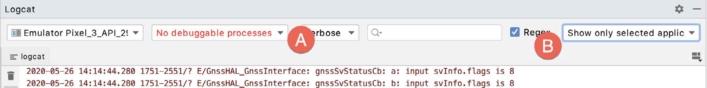
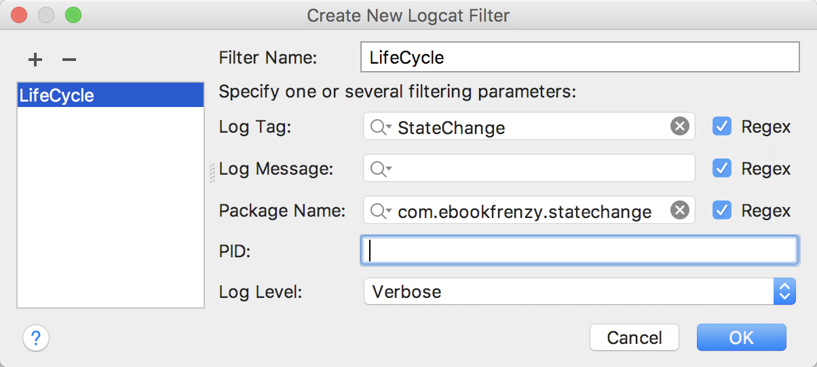
Using the Logcat panel
select the Edit Filter Configuration menu option

Slide 4
Saving and restoring android state
Automatic saving of state for a user interface view can be disabled in the XML layout file
android:saveEnabled property to false
putCharSequence() and getCharSequence() methods are used
override fun onSaveInstanceState(outState: Bundle?) {
super.onSaveInstanceState(outState)
Log.i(TAG, "onSaveInstanceState")
//Saving a state
val userText = binding.editText.text
outState.putCharSequence("savedText", userText)
}
override fun onRestoreInstanceState(savedInstanceState: Bundle?) {
super.onRestoreInstanceState(savedInstanceState)
Log.i(TAG, "onRestoreInstanceState")
//Restoring a state
val userText = savedInstanceState.getCharSequence("savedText")
binding.editText.setText(userText)
}

